Slide 1

Motion Retargeting for Grasping Tasks
Mapping Synergies from Human to Robotic Hands
Luca Colamarino, Giuseppe D’Addario, Federico Tranzocchi, Matteo Zamponi

Slide 2
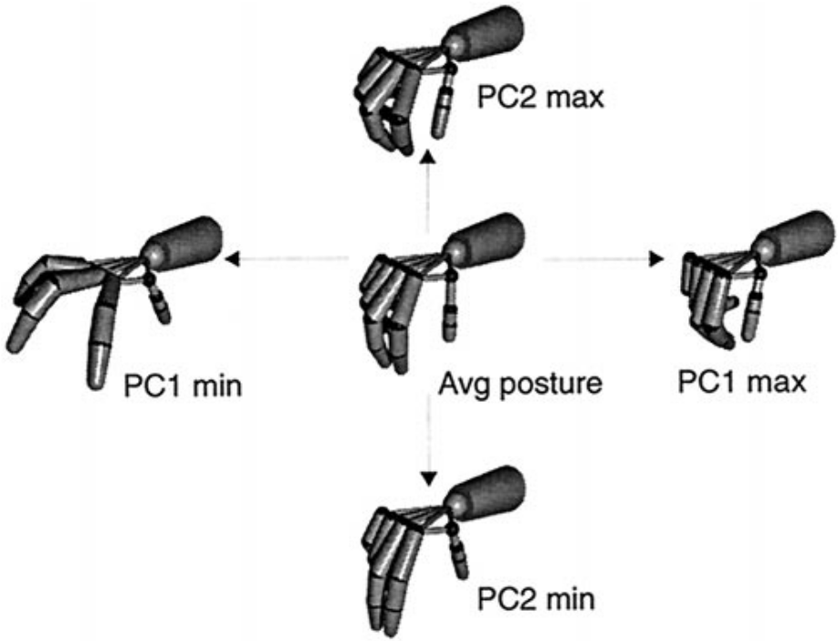
Synergies
Robotic hands have many DoFs; difficult to control manually.
Humans use Postural Synergies to simplify control.
Objective: Use human synergies to drive robots with different kinematics.

Slide 3
The Correspondence Problem
Human vs. Robot hands are rarely identical.
Joint Mapping: Fails on non-anthropomorphic robots.
Fingertip Mapping: Fails to respect internal joint limits/collisions.

Slide 4
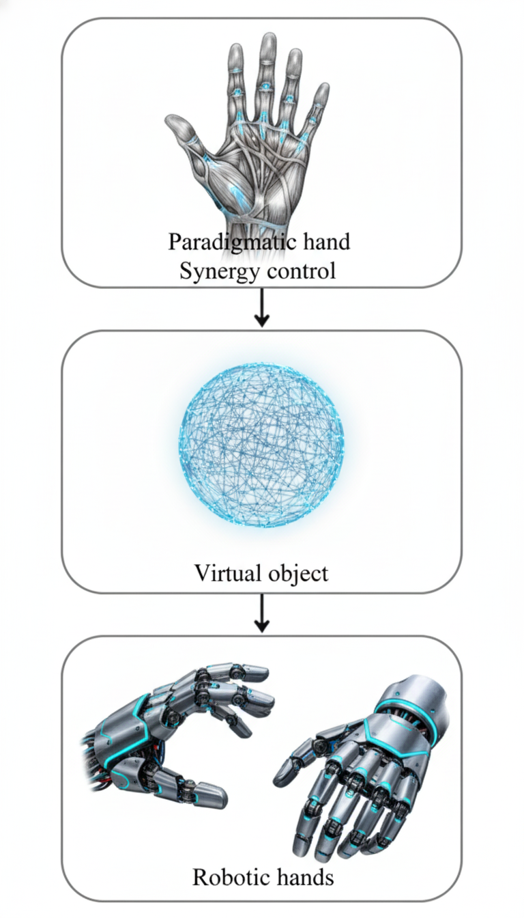
The solution: Virtual Sphere
Based on Gioioso et al. (2013).
Map the object, not the hand.
A virtual sphere fits inside the hand; as the hand moves, the sphere deforms.
The robot acts to match this sphere deformation.

Slide 5
System Pipeline
Acquisition
The Weart TouchDIVER G1 haptic glove captures sensor data.
Reconstruction
The server processes the glove inputs using a neural network to reconstruct the full pose of the virtual human hand in Unity.
Transmission
The reconstructed joint angles are sent to the Unity simulation in realt-time.
Retargeting
Actuation
The resulting joint velocities are integrated to update the visual pose of the robotic hand in the simulation.
The Unity retargeting algorithm maps the virtual sphere deformation to the joint velocities of the target robotic hand.

Slide 6
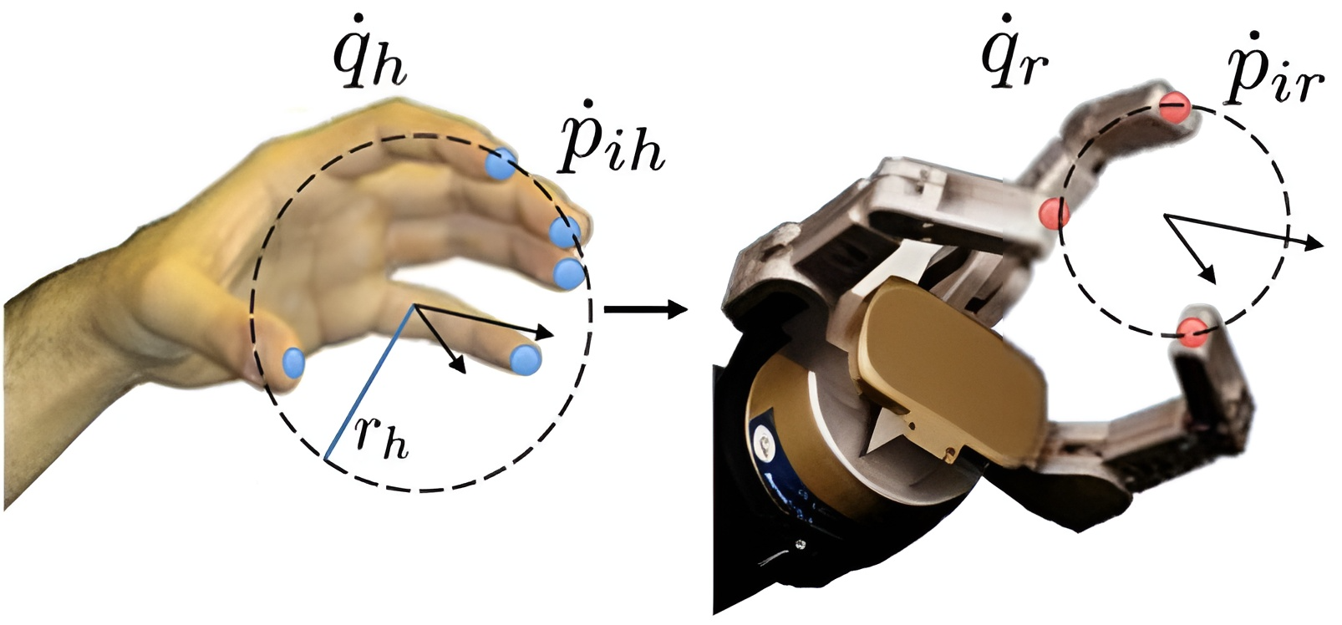

Mathematical Framework
Interaction Matrix ($A$): Relates fingertip velocity to sphere velocity.
Scaling ($k_{sc}$): Matches human hand size to robot hand size.
Solver: Damped Least Squares (DLS) for stability.

Slide 7
Redundancy Resolution
Used for the Mia Hand (High DoF).
Null-Space Projection: Optimizes internal joints without affecting the grasp.
Goal: Keep joints centered (away from physical limits).

Slide 8
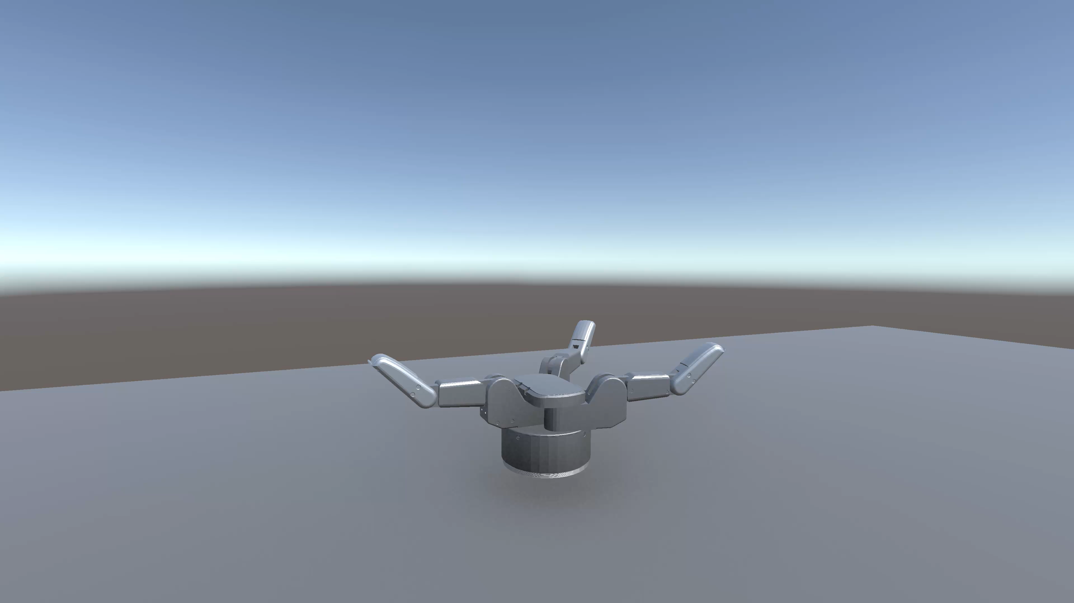
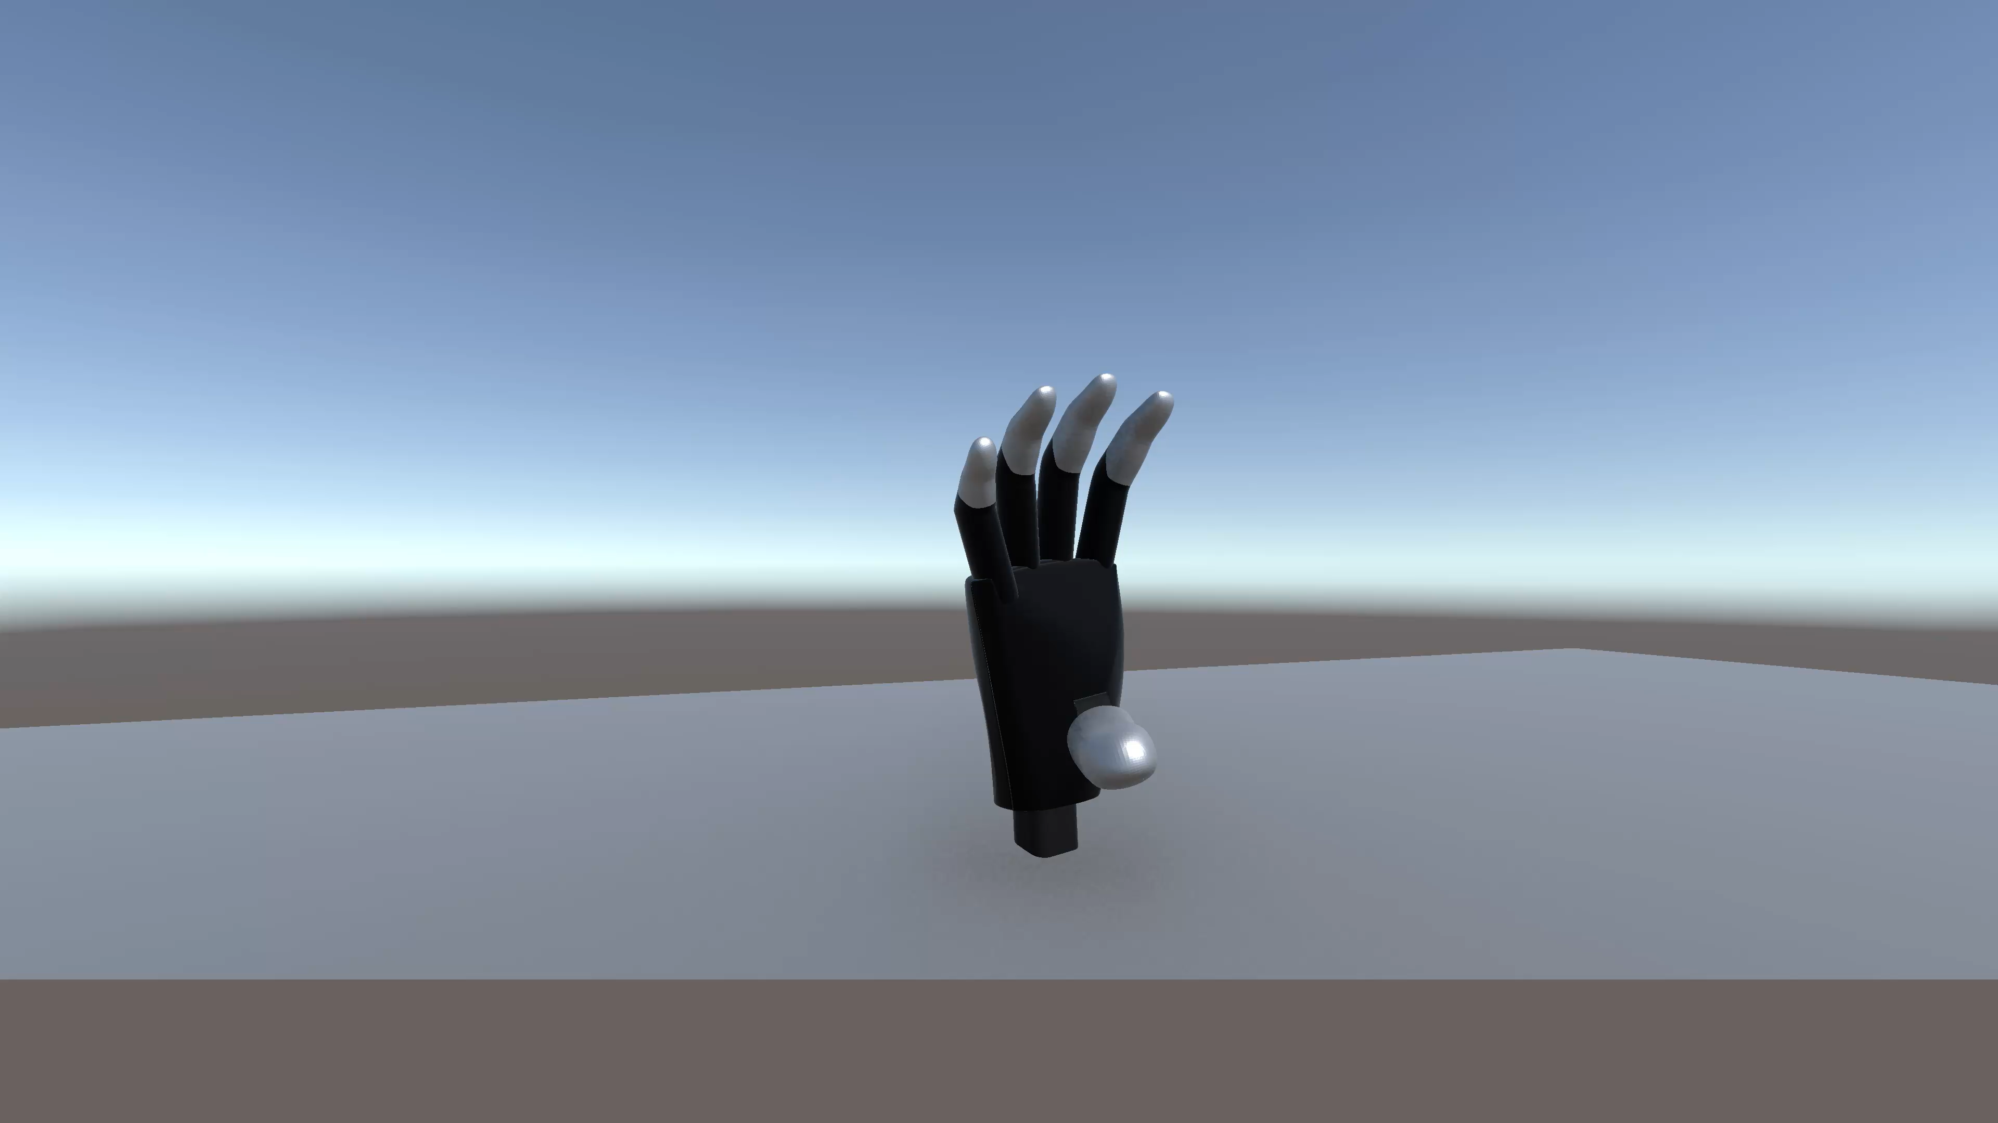
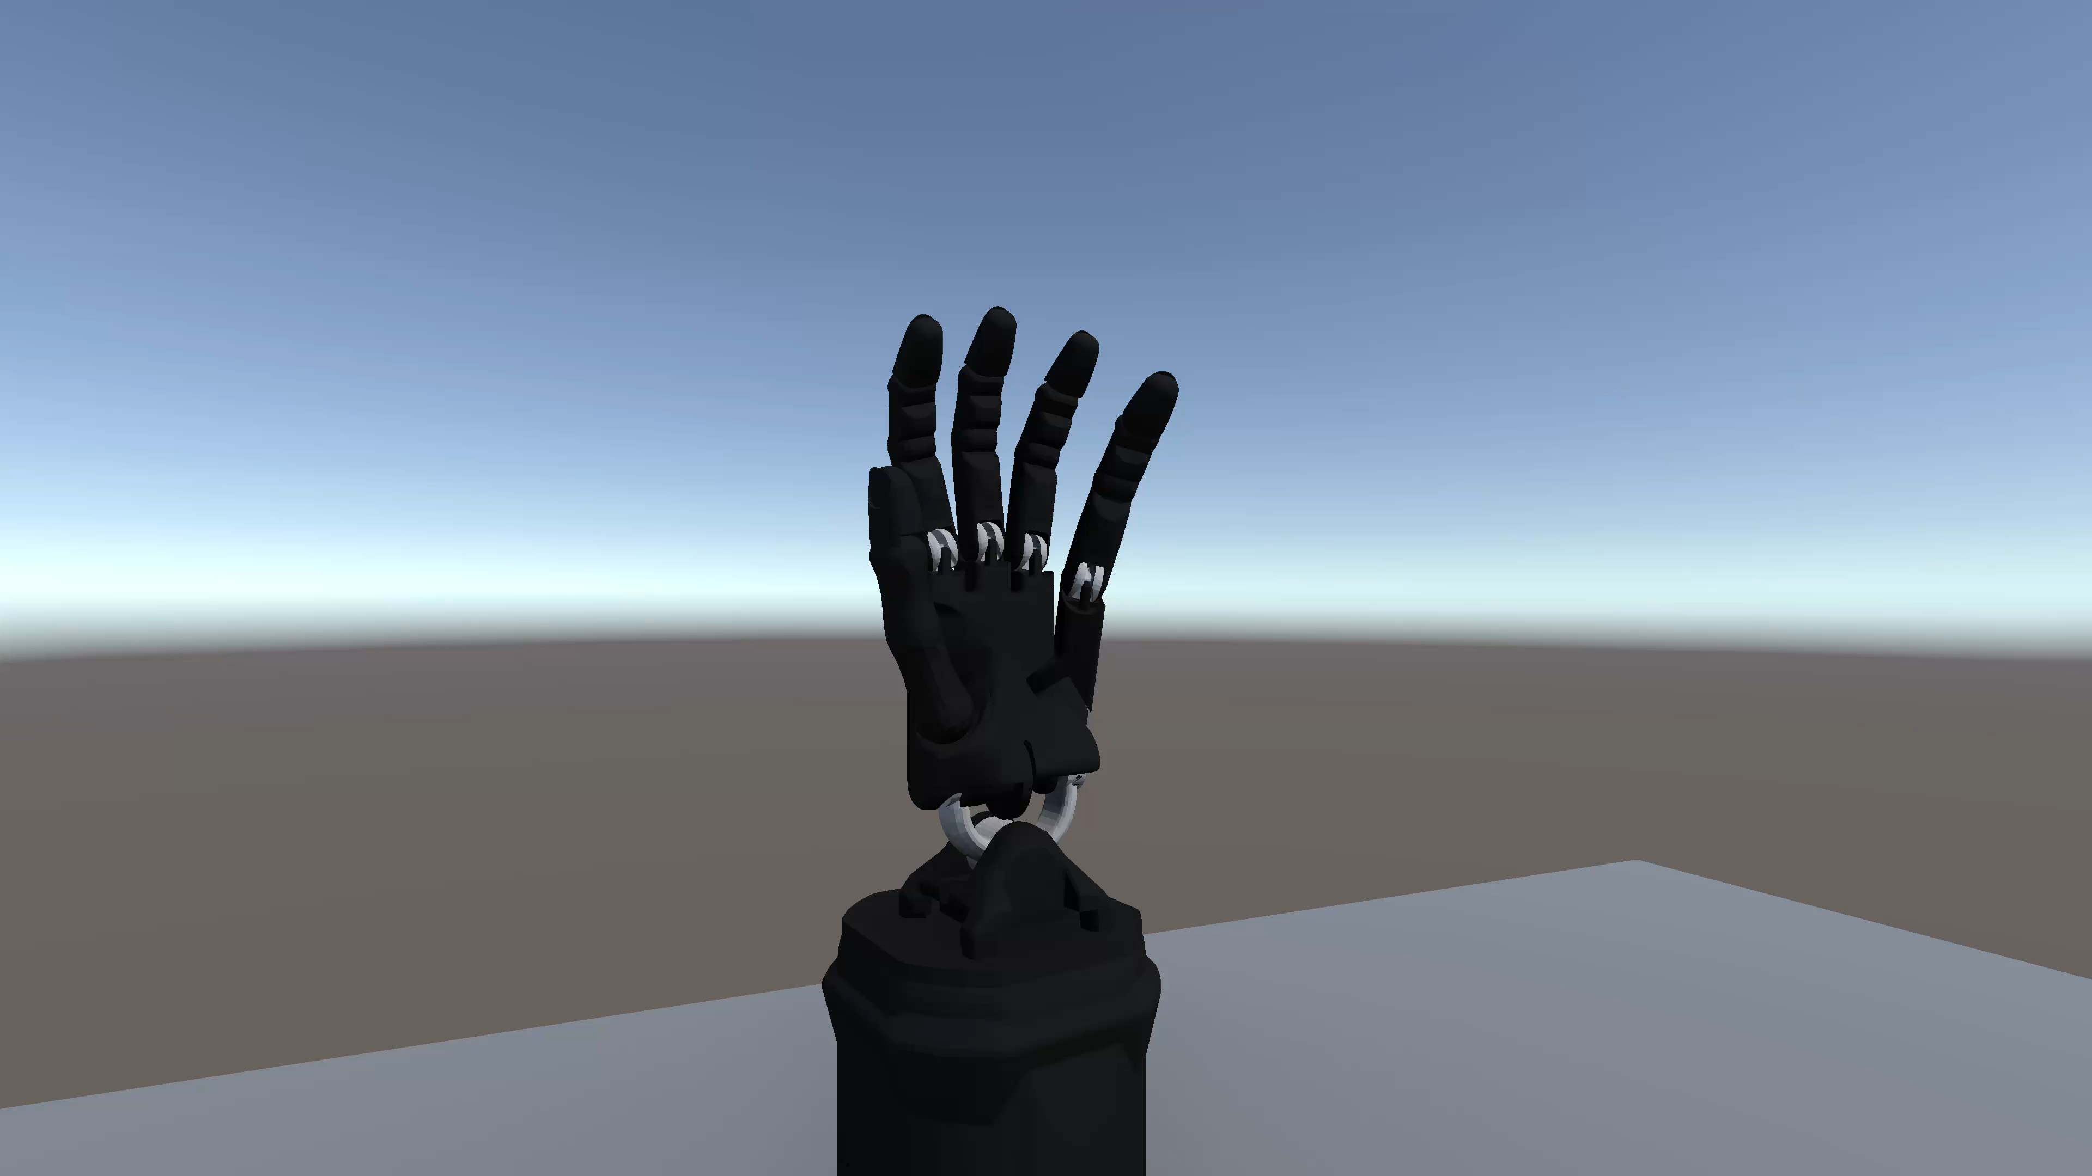
Robot Models
Barrett Hand: 3 Fingers, Non-anthropomorphic. Tests adaptability.
Mia Hand: 5 Fingers, Anthropomorphic. Tests redundancy handling.
Shadow Hand: 5 Fingers, Antropomorphic.

Slide 9
Results

Slide 10
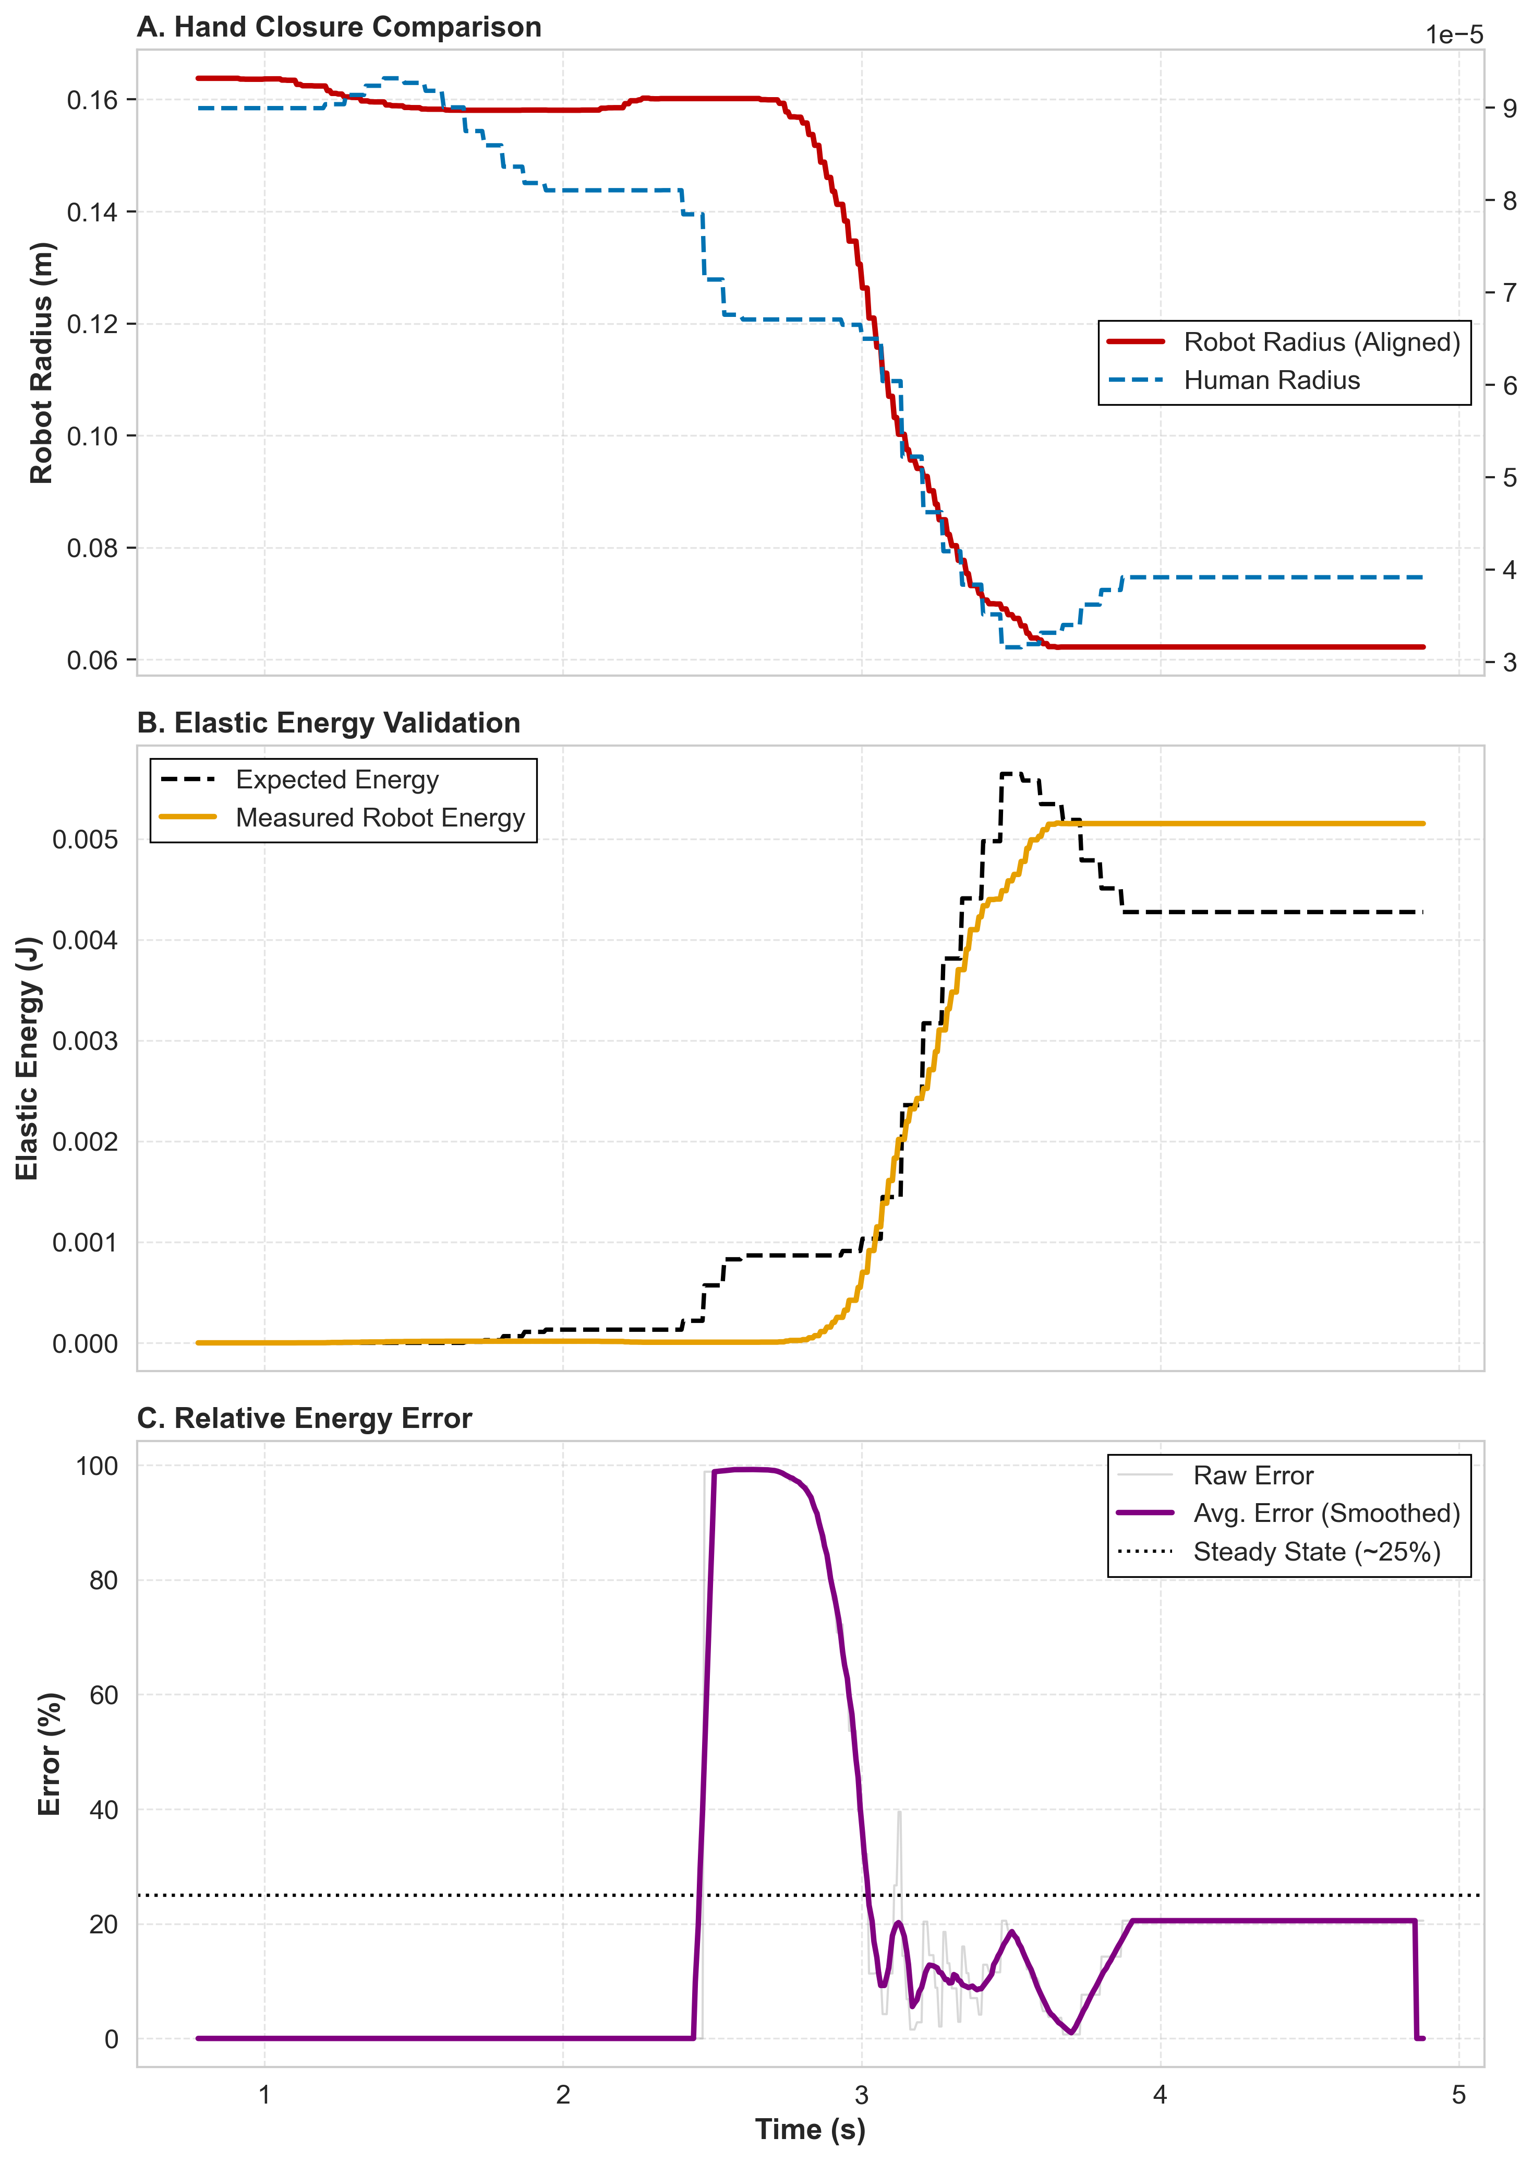
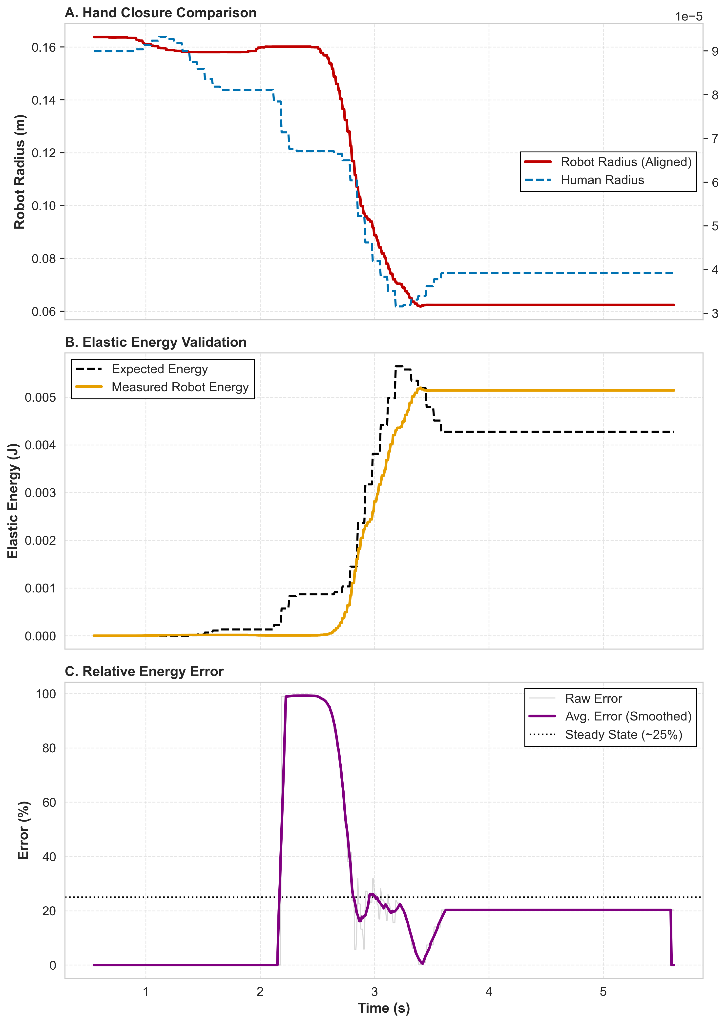
Grasp barrett null-space and not

Slide 11
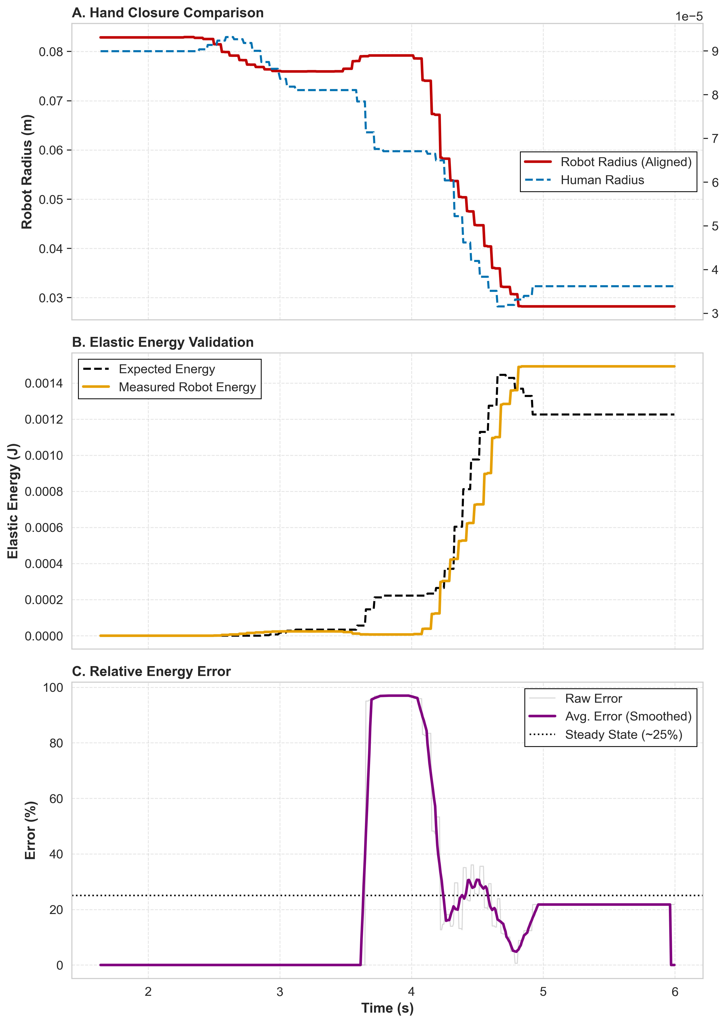
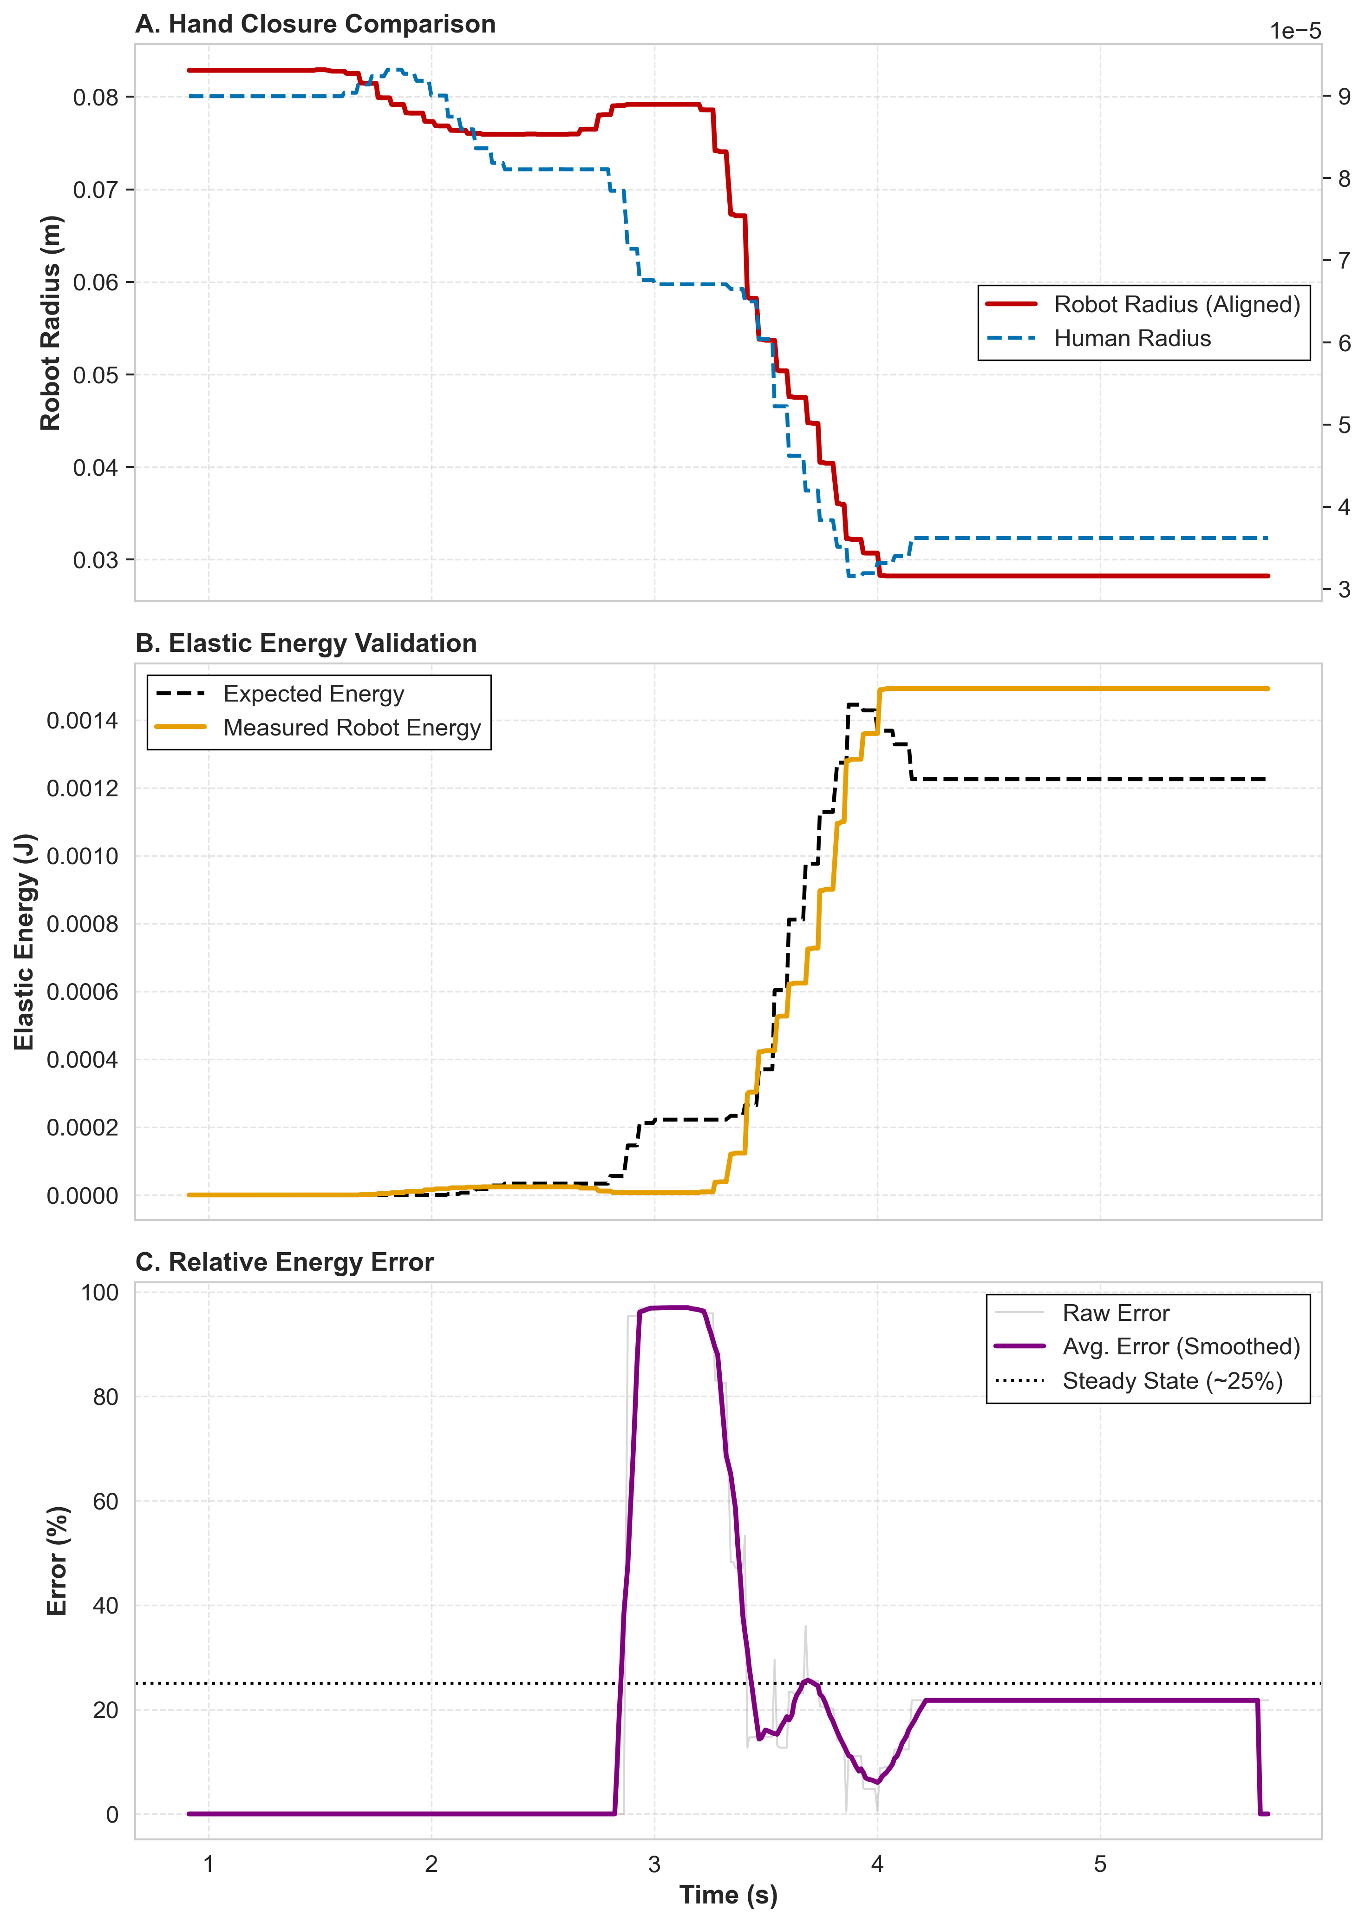
Grasp Mia null space and not

Slide 12
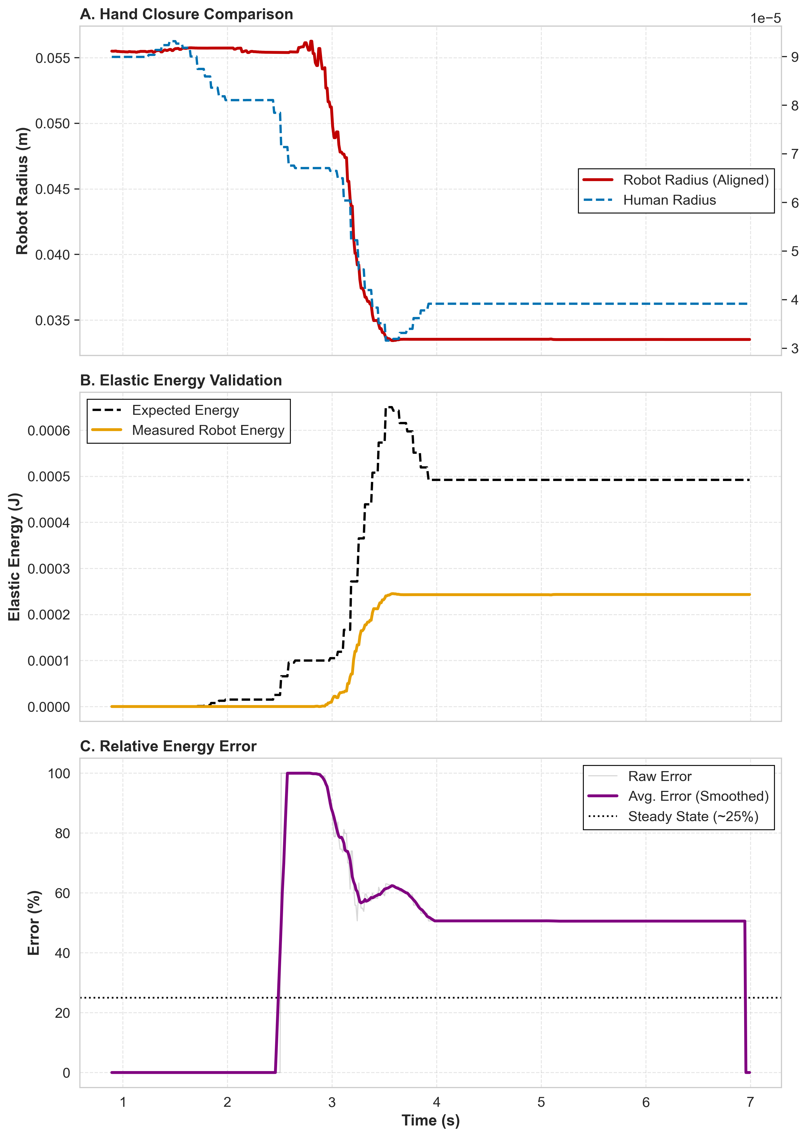
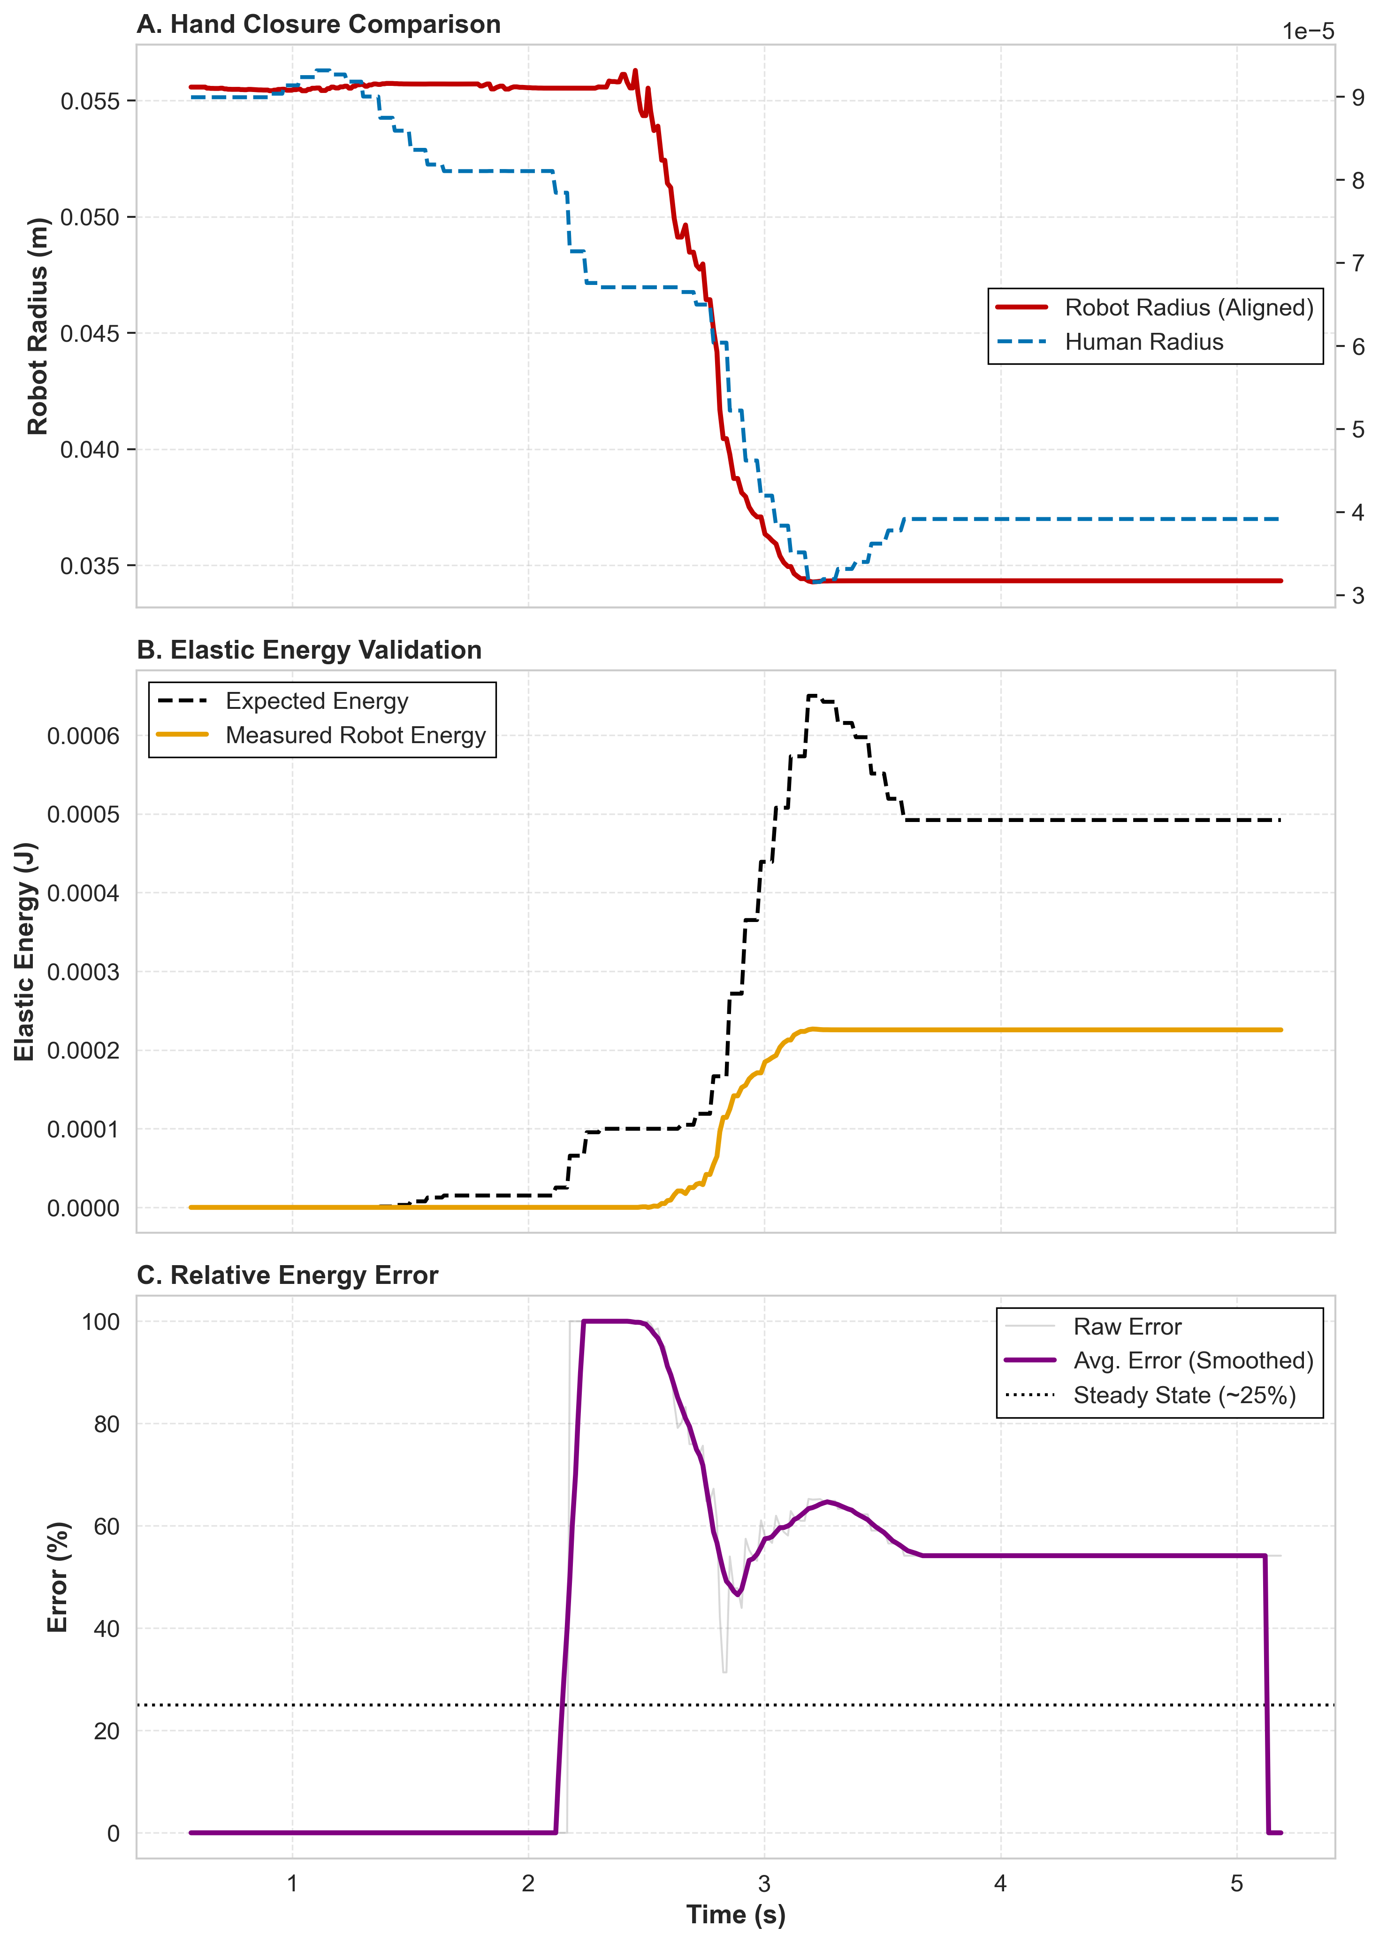
Grasp Shadow Hand null-space and not

Slide 13
Conclusion

